Slide 1


MARKETING YOUR BUSINESS IN THE NEW AGE
ASSISTANT PROFESSOR, BYUH
TSERENNYAM SUKHBAATAR

Slide 2
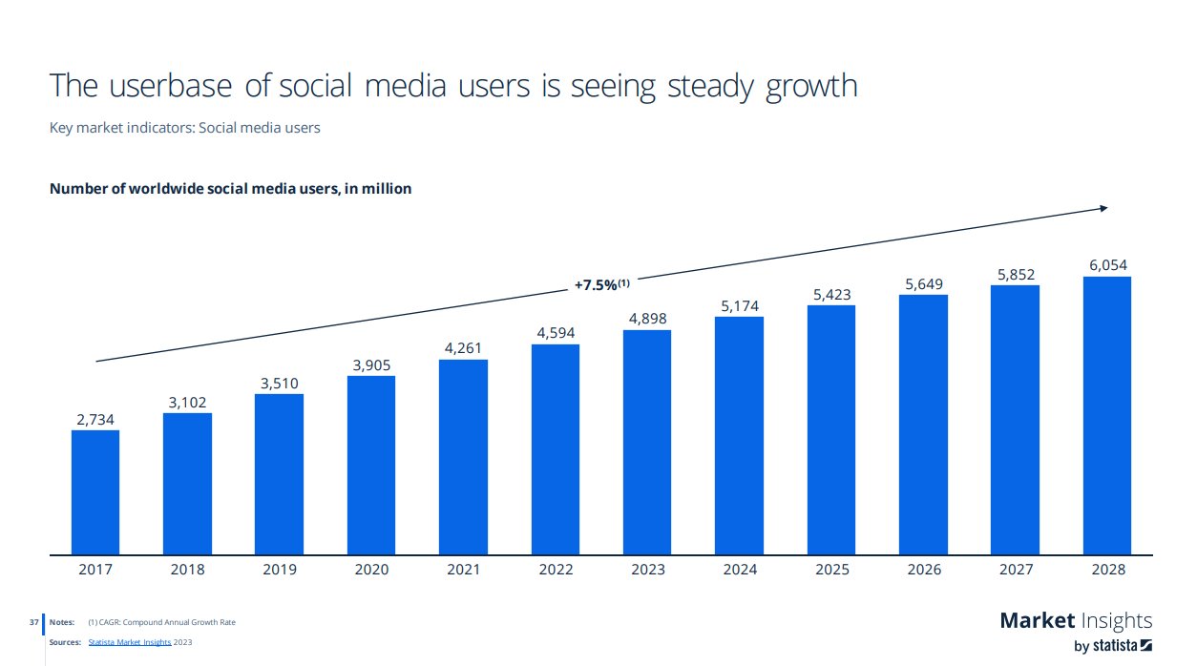

Slide 3

Expected budget changes for selected advertising channels in the next 12 months according to marketing professionals worldwide as of December 2023
Marketers' budget changes for ad channels worldwide in the 12 months following 2023
Share of respondents
Note(s): Worldwide; December 5 to 21, 2023; 1,514 respondents; among marketers at or above a manager level across multiple industries
Further information regarding this statistic can be found on page 8.
Source(s): Nielsen; Inside Radio; ID 1339016
2

Slide 4
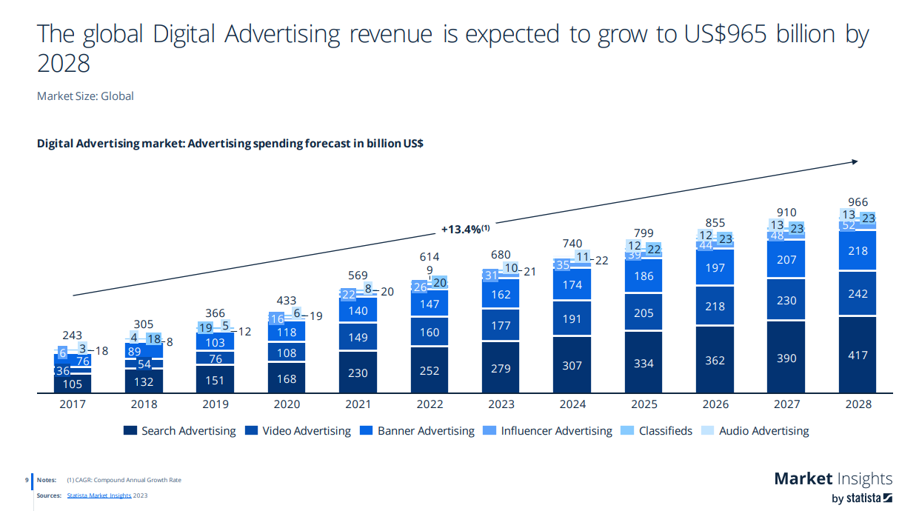

Slide 5
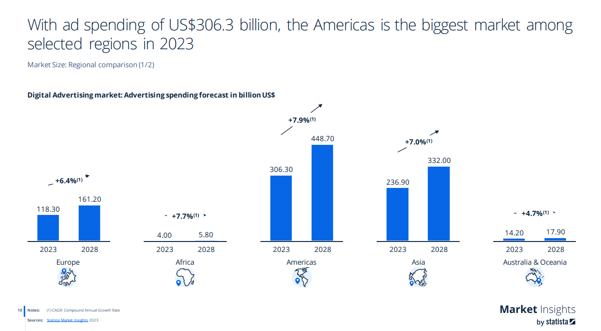

Slide 6
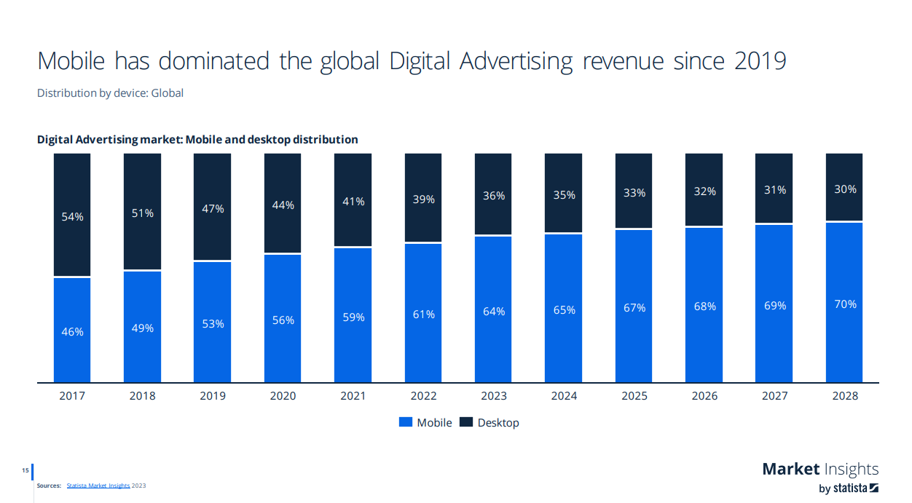

Slide 7
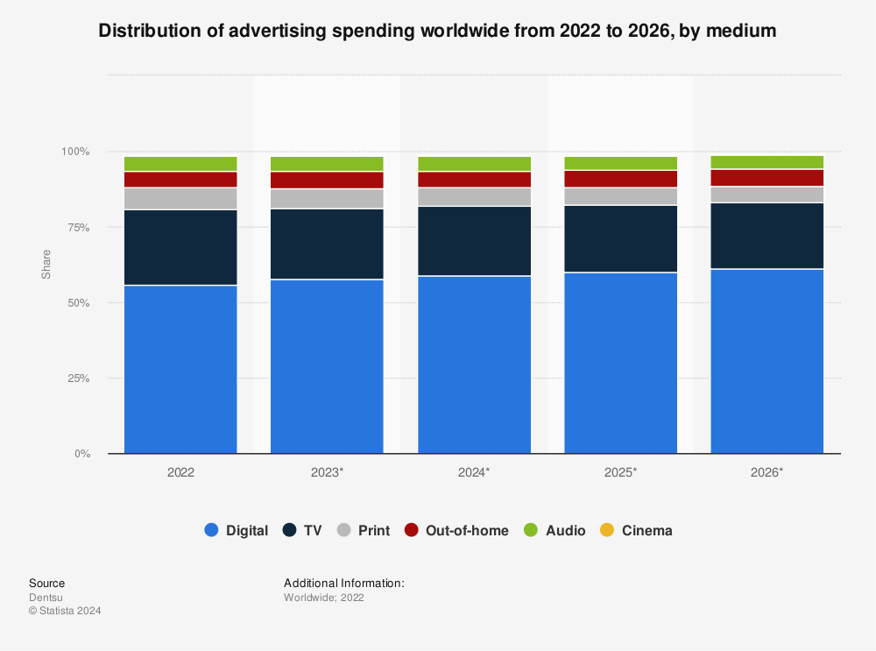

Slide 8


Slide 9

BABY FOOD

Slide 10
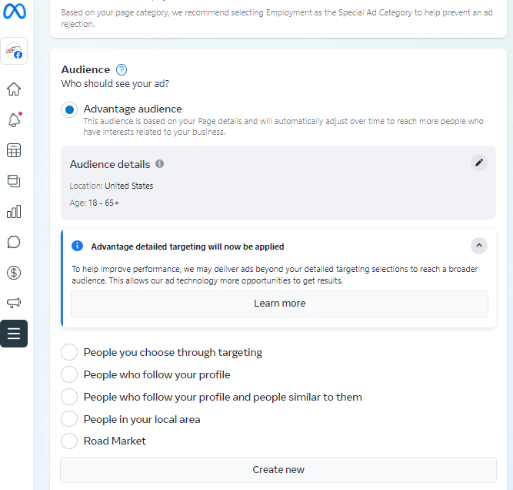
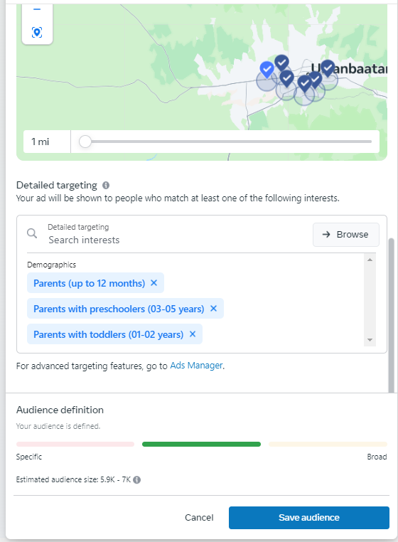
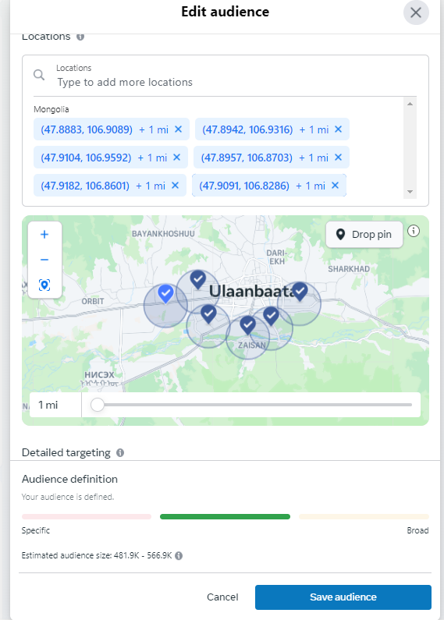

Notes:
Narrow down your audience
Pin your location – Don’t waste your money
Choose specific target customers – Parents with preschoolers

Slide 11

Manage your google maps business

Slide 12
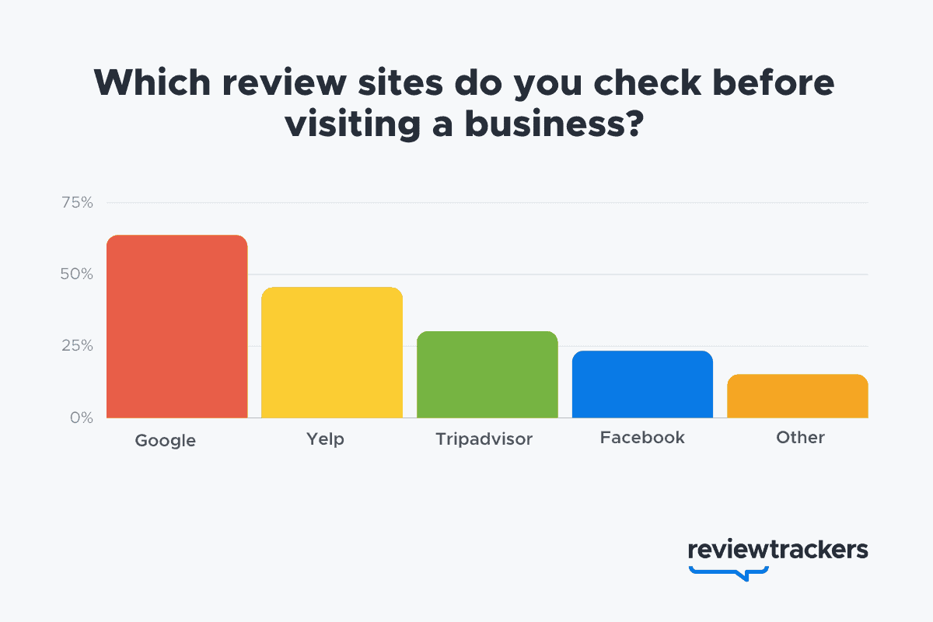
Notes:
First, I wanna share a few facts. Google is worldwide. Yelp is only for US.

Slide 13

63.6%
of consumers say they are likely to check reviews on
Notes:
of consumers say they are likely to check reviews on Google (through Google Maps and Search) before visiting a business location — more than any other review site.

Slide 14

Review interaction
50%
Notes:
Review interaction is up by 50% from pre-pandemic levels.

Slide 15


Notes:
Customers usually don’t trust companies with lower than 4-star ratings.

Slide 16




TOP BUSINESS REVIEW SITES (DISTRIBUTION)
73%
6%
3%
3%
Notes:
Based on top directories analysis by ReviewTrackers, roughly 75% of new business is influenced by only a handful of business review sites and directories: Google, Facebook, Yelp, Tripadvisor, Apple Maps, and Bing Maps.

Slide 17
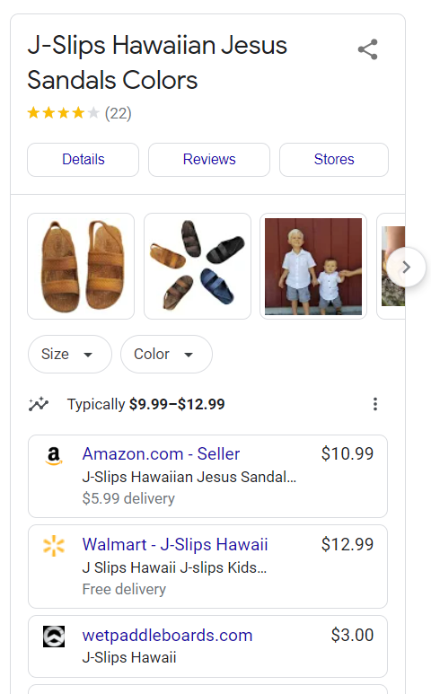
BENEFITS
MANAGING REVIEWS
ADDING PRODUCTS
CREATING PROMOTION
GETTING INSIGHTS
CREATING ADS so on

Slide 18
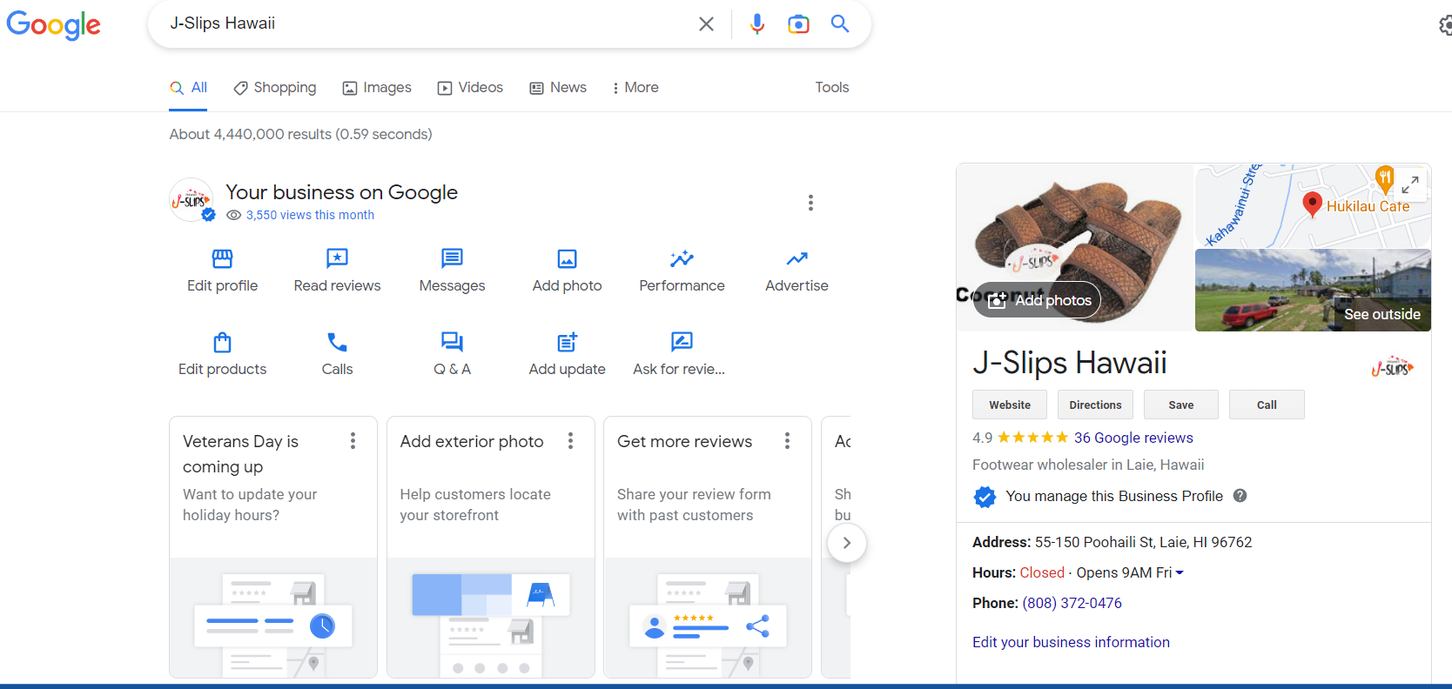

Slide 19
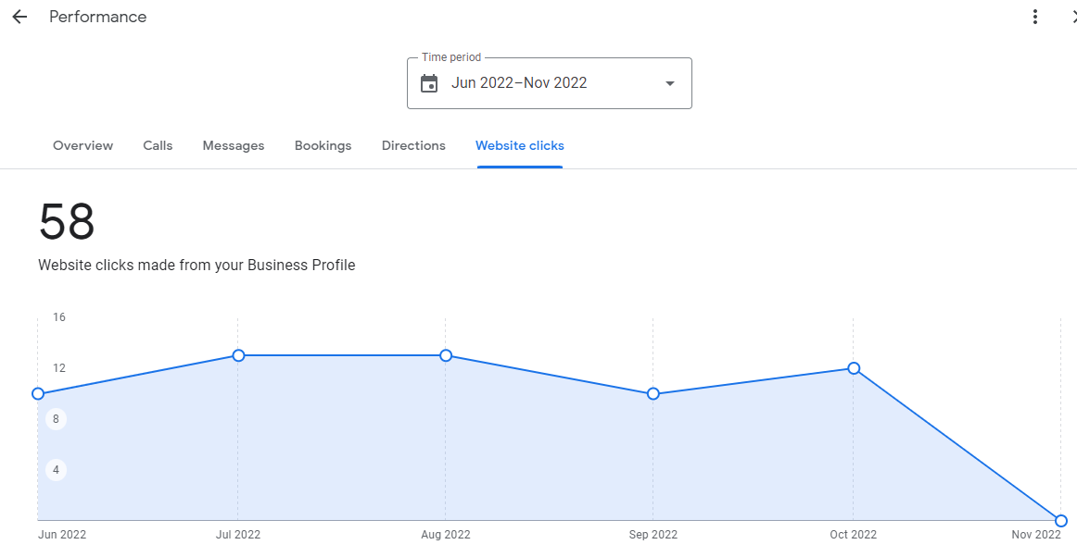

Slide 20
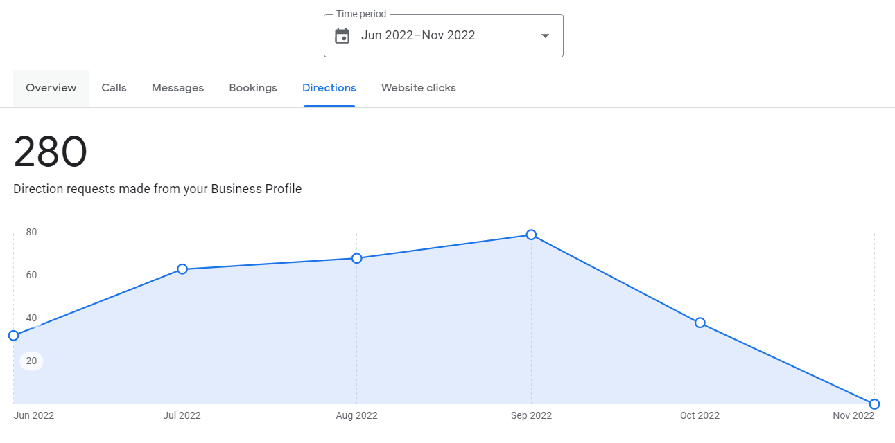

Slide 21
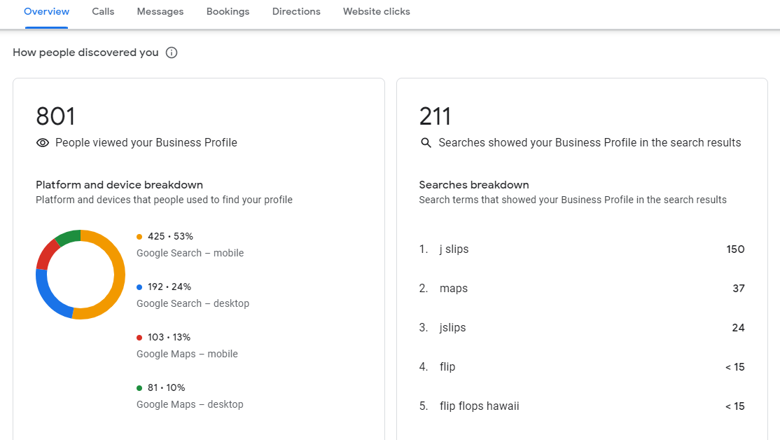
Keywords for Google, Facebook, Instagram, TikTok Ads & #Hashtags
Notes:
These are the Keywords for Google, Facebook, Instagram, TikTok Ads & #Hashtags to improve search engine optimization and leads. Or to improve sales!

Slide 22
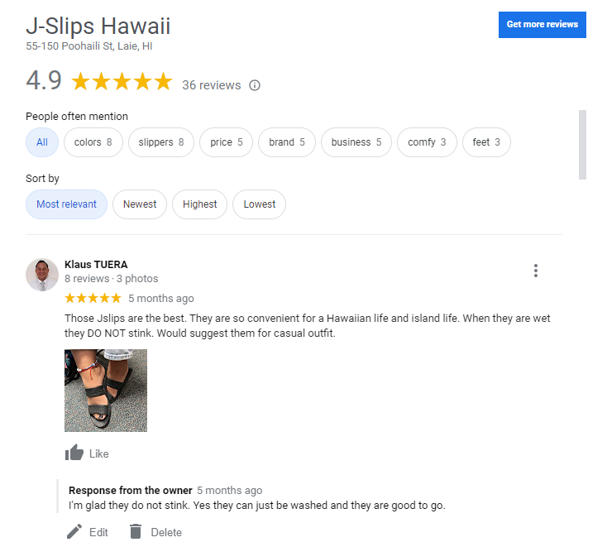
Notes:
Managing reviews

Slide 23
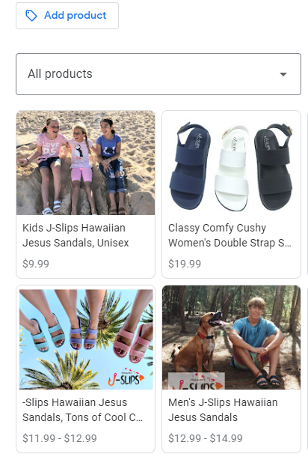
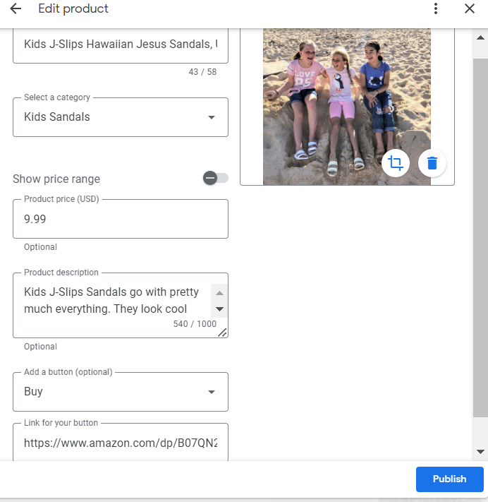
Notes:
Adding more products and creating your online store.

Slide 24



